Slide 1

Project Management Methodology

Slide 2


PMO
A management structure that standardizes the project-related governance processes and facilitates the sharing of resources, methodologies, tools, and techniques
Roles and Responsibilities
Identifying and developing project management methodology, standards, and Policies.
Governance and compliance with project management standards, policies, procedures, and templates by means of project audits
Ensure good project communication across Elm.
PMs coaching and training.
Support top management to decision making.

Slide 3
New Project Management Process
Initiating | Planning | Execution | Closing
No
Develop Project Plan
Approved?
Hold Kick-Off meeting
Close Procurement
Develop WBS
START
Yes
Develop Schedule
Additional Budget ?
Finalize Lessons Learned log
Assign Project Manager
No
Execute Tasks
Project Request
Yes
Develop Communication Plan
Addition Budget Approval
Develop Charter
Close & Archive Project
Deliverables
Develop Risk Register
Approved?
No
Budget Allocation
Yes
END
Project plan Approval
Set Project Baseline
Acceptance Criteria
Process

Slide 4
New Project Management Process
Monitoring and Control
Acceptance Criteria
Change Request
Issue Management
Deliverables Acceptance Process
Propose Plan Update
Set New Baseline
Identify and Analysis
PMO Corrective Action
Fill up Change Request
Update Change Log
Corrective Action
Yes
Go to Execution Phase
Resolved?
Approved?
No
No
Yes
PMO Review
Escalation Process
Go to Execution Phase
No
Go to Closing Phase
Resolved?
Yes
Approved?
Yes
Update Issue Log
No

Slide 5


Change Areas
01
01
Revised KPIs
02
New Budget Allocation Process
03
01
New DAF Tracking
04
New Escalation Process
New Sponsorship Responsibilities and Duties
01
05
06
New Project Management System

Slide 6







Project Request
01
01
01
01
02
03
Project Types
Project Template
Project Information
Waterfall
Customer Name
Project Name
Opportunity Number
Program
Stand Alone
IT Waterfall
Service Line
Sector
Agile
Project name as in contract
Project
Account Manager
Construction
Project Value
Duration

Slide 7



Project Initiation
START
Assign Project Manager
Assign Project Manager
Develop Charter
Budget Allocation
Develop Charter
Assigned by project dispatcher
Project Start Date
Project Financials
Contract Information
Payments Term
Budget code structured based on project type.
Freeze the budget code if the project plan not completed.
Budget Allocation

Slide 8






Project Planning
No
Develop WBS
Develop Schedule
Develop Communication Plan
Develop Project Plan
Approved?
Develop WBS
PO Planning
Project Activities
Others
Risk Response Plan
Contingency
Task Dependencies
Critical Path
Project Milestone
Deliverables
Payment Terms
Project Resources
Key Messages & Events
Delivery Method
Audience
Date & Frequency
Owner
Yes
Develop Schedule
Additional Budget ?
No
Yes
Develop Communication Plan
Addition Budget Approval
Develop Risk Register
Project Plan Approval
Set Baseline
Develop Risk Register
Approved?
No
Risk Identification
Risk Analysis
Risk Response Plan
Risk Ownership
PMO Compliance
Sponsor Approval
Finance if budget changed
Benchmark the project.
KPIs start counting
Yes
Project plan Approval
Set Project Baseline

Slide 9


Project Execution
Hold Kick-Off meeting
Hold Kick-Off meeting
Execute Task
Execute Tasks
Introductions
Executive Summary
Scope and Deliverables
Roles and Responsibilities
Timelines
Communication and Meeting Plans
Project schedule updated on EPM
All documents uploaded on EPM
Deliverables
Acceptance Criteria
Process

Slide 10




Project Monitor and Control
Acceptance Criteria
Change Request
Issue Management
The criteria for accepting project deliverables
Deliverables Acceptance Process
Acceptance Criteria Template
Change Request Process.
CR Supporting Materials
Impact of CR
Assessment the priority of CR
CR Form
PMO & Finance Compliance
Identify issues.
Issue log and prioritization
Analyze and Impact
Corrective Action
Monitor and Review
PMO Corrective Action
Escalation Process

Slide 11



Project Closing
Close Procurement
Closing Project Procurements
Finalize Lessons Learned Log
Close & Archive Project
Finalize Lessons Learned log
Identify comments and recommendation.
Documents and share findings
Analyze and organize for application of result
Record it on lesson learned log.
Retrieve for use in current or future projects
All documents and deliverables are up-to-date.
All issues resolved.
Confirming certificate of completion by customer
All costs are charged to the project.
Closure form.
Closure process.
Finalizing Open POs & GRs
Update records on SAP and EPM
Close & Archive Project
END

Slide 12
EPMM: Project Performance Management (EPM KPIs)
KPI & Levels
Schedule KPI
Performance KPI | Weight
Schedule KPI | 50%
Cost KPI | 30%
PMO Compliance | 20%
Performance KPI | 5 | 4 | 3 | 2 | 1
Schedule KPI | 4% | 7% | 10% | 17% | 25%
Cost KPI
Score Scale | 5 | 4 | 3 | 2 | 1
Project Cost | 95.0% | 97.5% | 100.0% | 102.5% | 105.0%
KPI _{Overall} = 0.5*KPI _{Schedule}+ 0.3*KPI _{Cost} + 0.2*KPI _{PMO Compliance}
If Cost ≤ 80%
Score Scale | 5 | 4 | 3 | 2 | 1
Project Cost | 80.0% | 70.0% | 60.0% | 50.0% | 40.0%
PMO Compliance
Score Scale | 5 | 4 | 3 | 2 | 1
Project Compliance | 100% | 97.5% | 95% | 92.5% | 90%

Slide 13


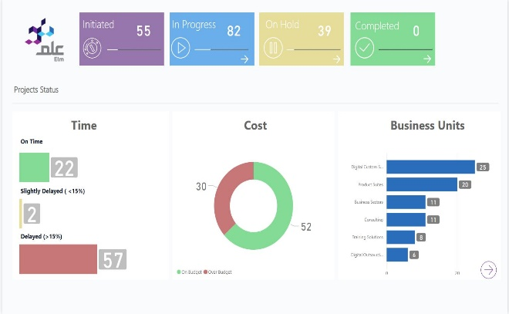
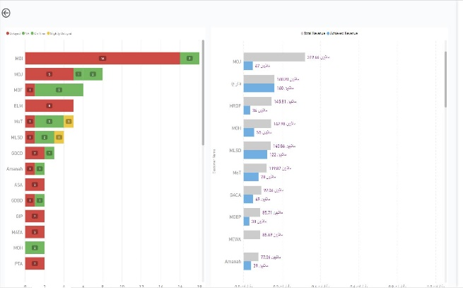


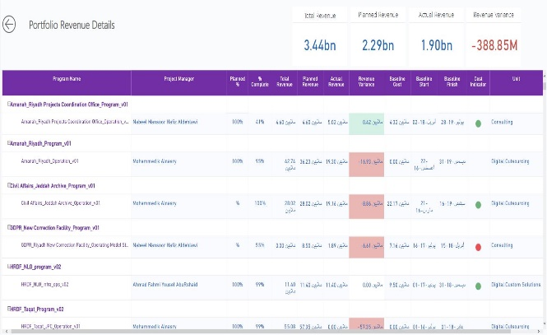
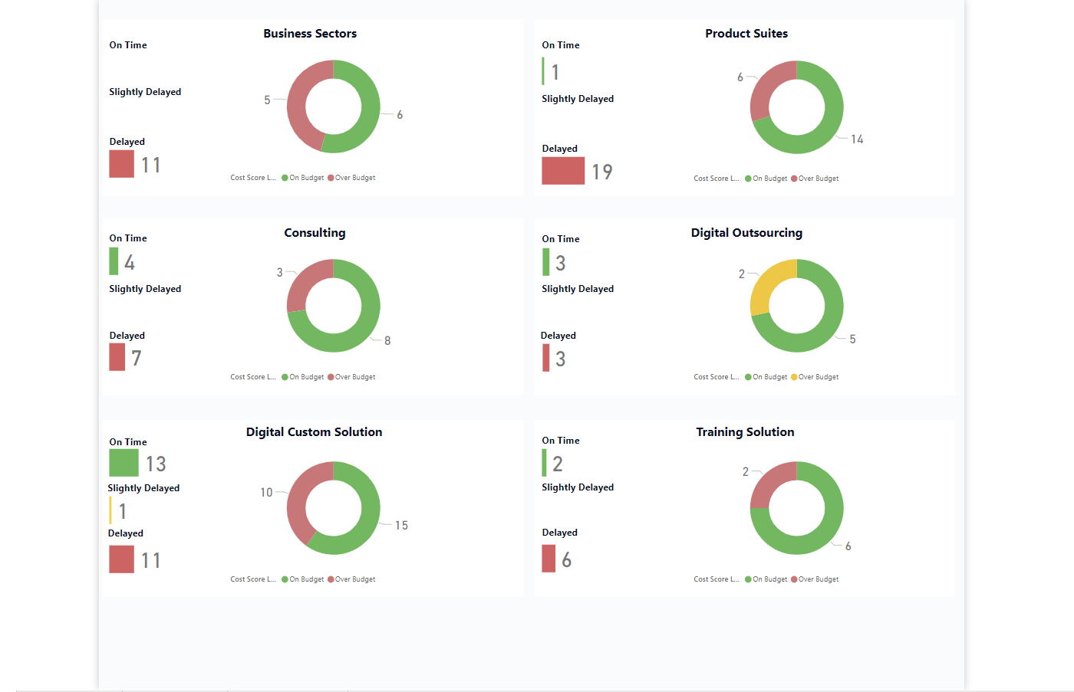
PMO Dashboard
Project Status Report
Portfolio Report
Revenue Report
Business Unit Project Status Report

Slide 14

Project Management System Demo

Slide 15
Open New Project

Slide 16
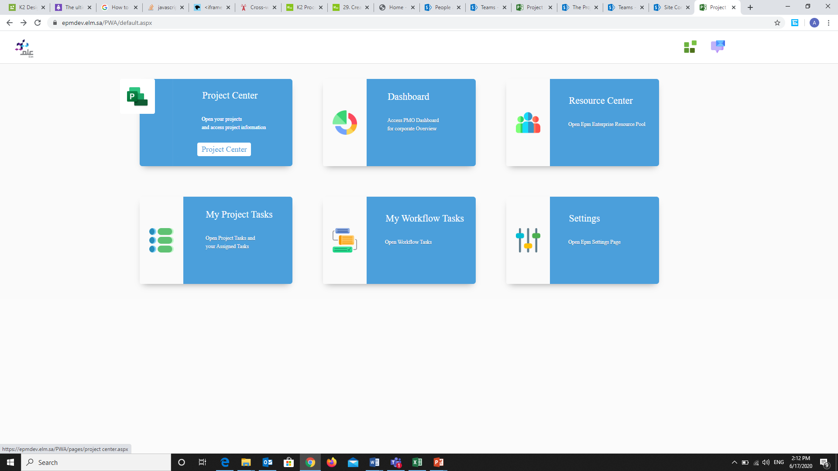
1

Slide 17
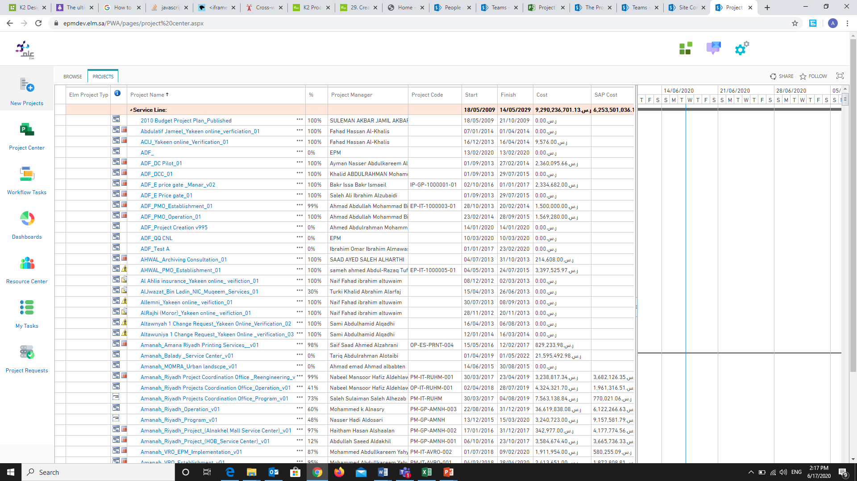
2

Slide 18
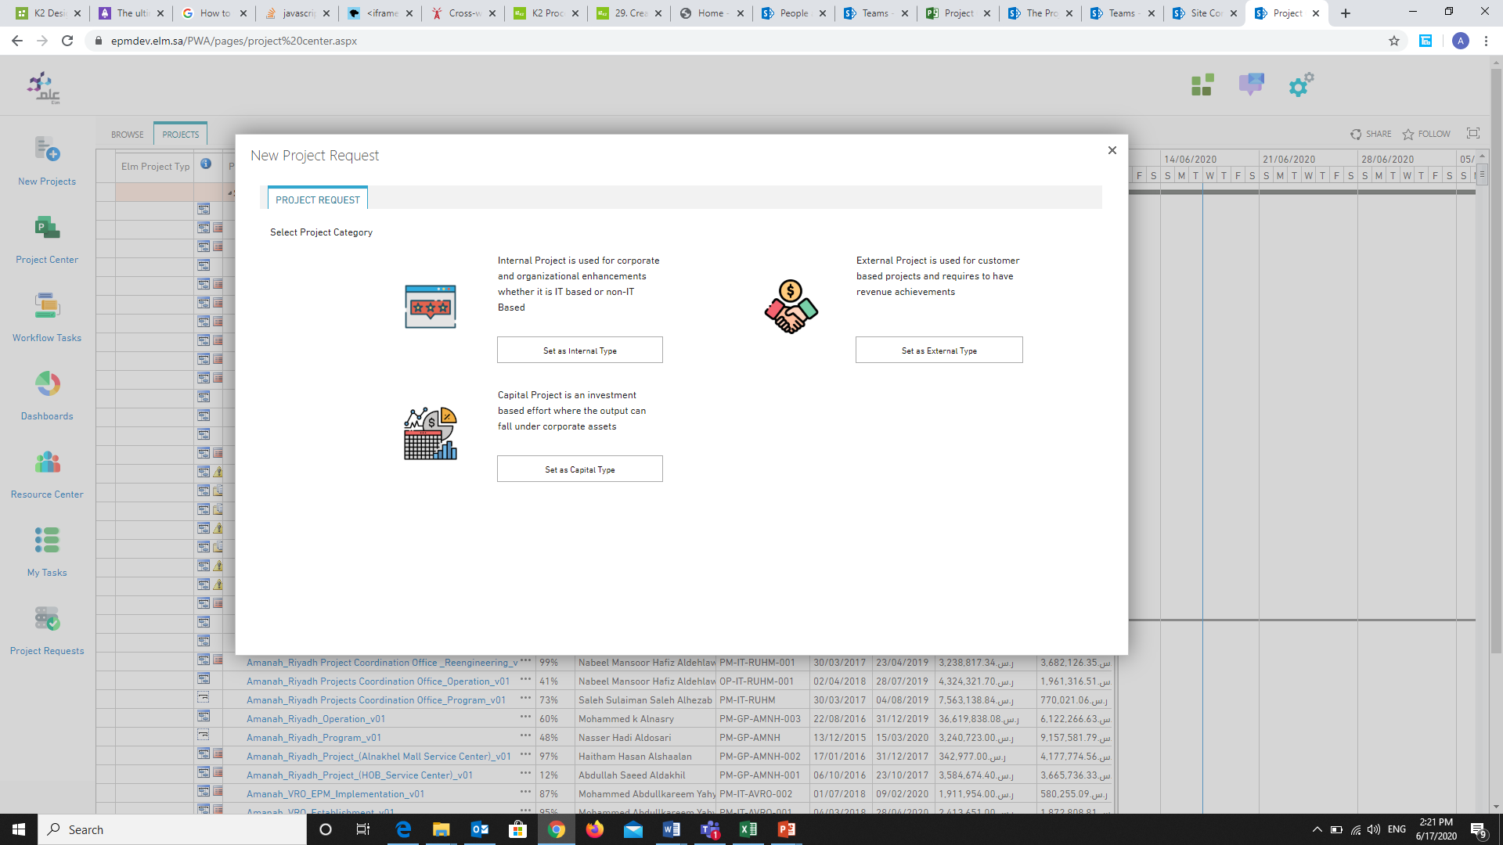
Here you have to choose one of these

Slide 19
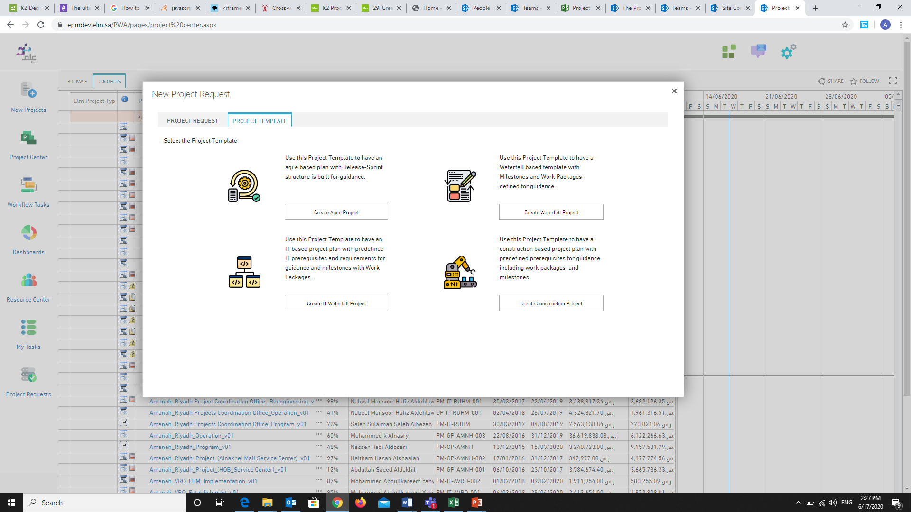
As well here you have to choose one of these

Slide 20
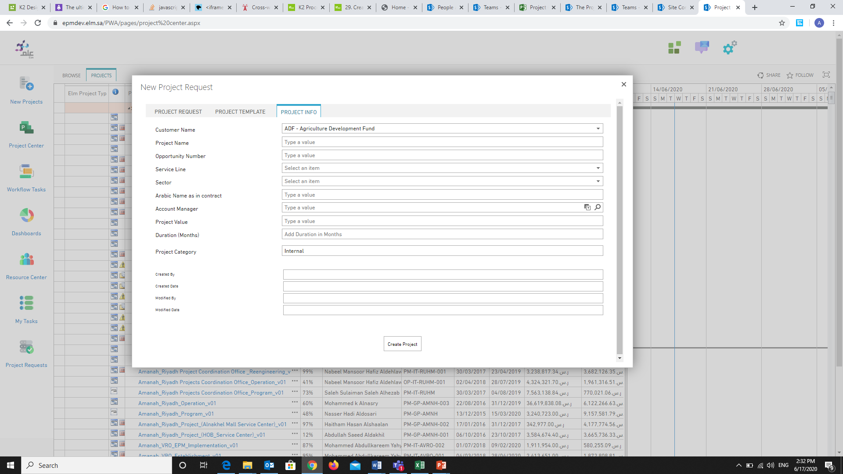
The user has to fill all those field
From 1 to 8
1
2
3
4
5
6
7
8
The rest of fields it will be auto fill
The rest of fields it will be auto fill

Slide 21
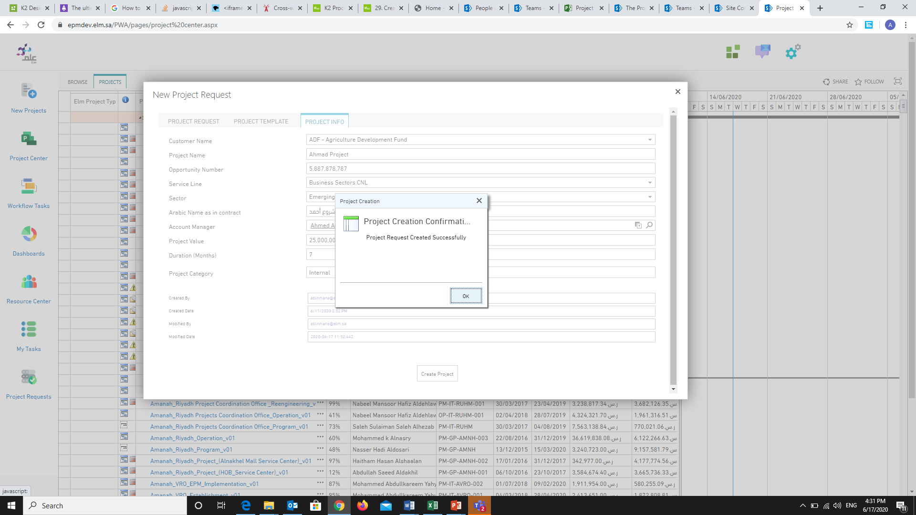
When you clicked on “Create Project” this message will appear

Slide 22
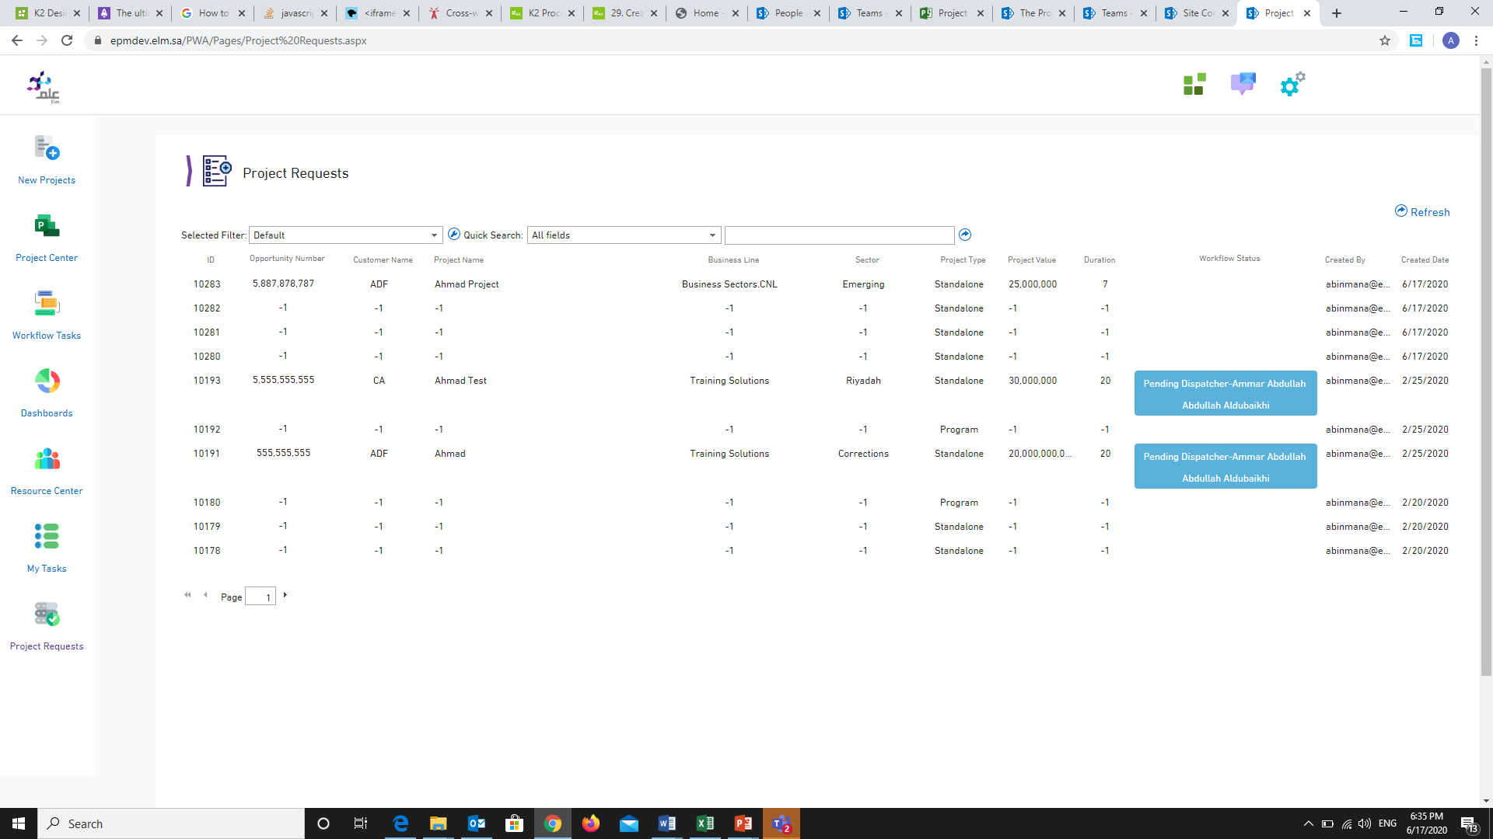
Here you can see your project
NOTE:
You have to refresh the page after one minute

Slide 23
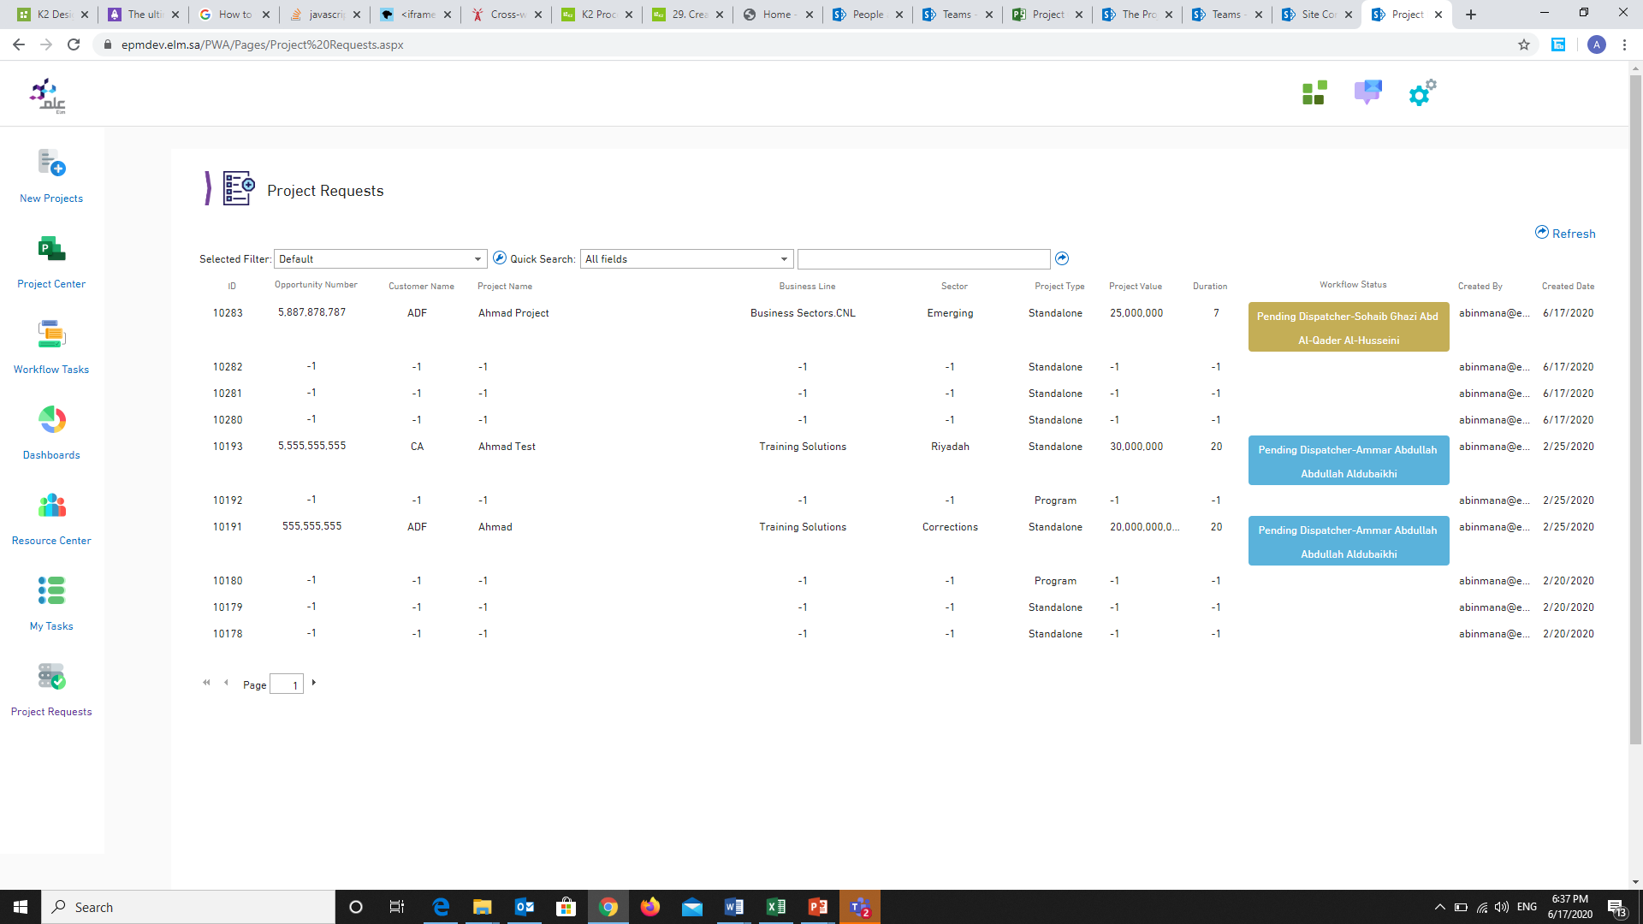

Slide 24
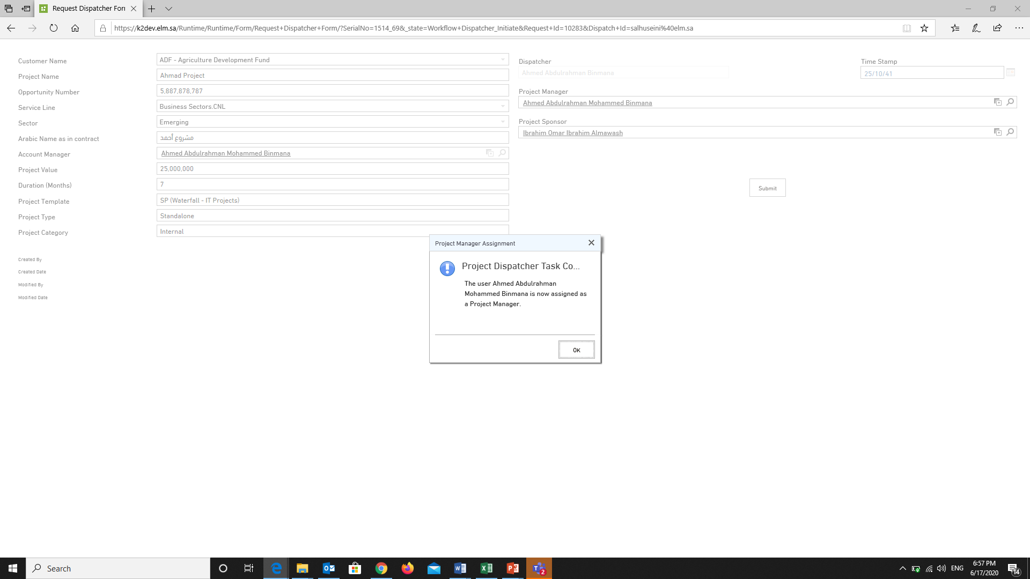
This page for PMO Team to revise the project then submit it.

Slide 25
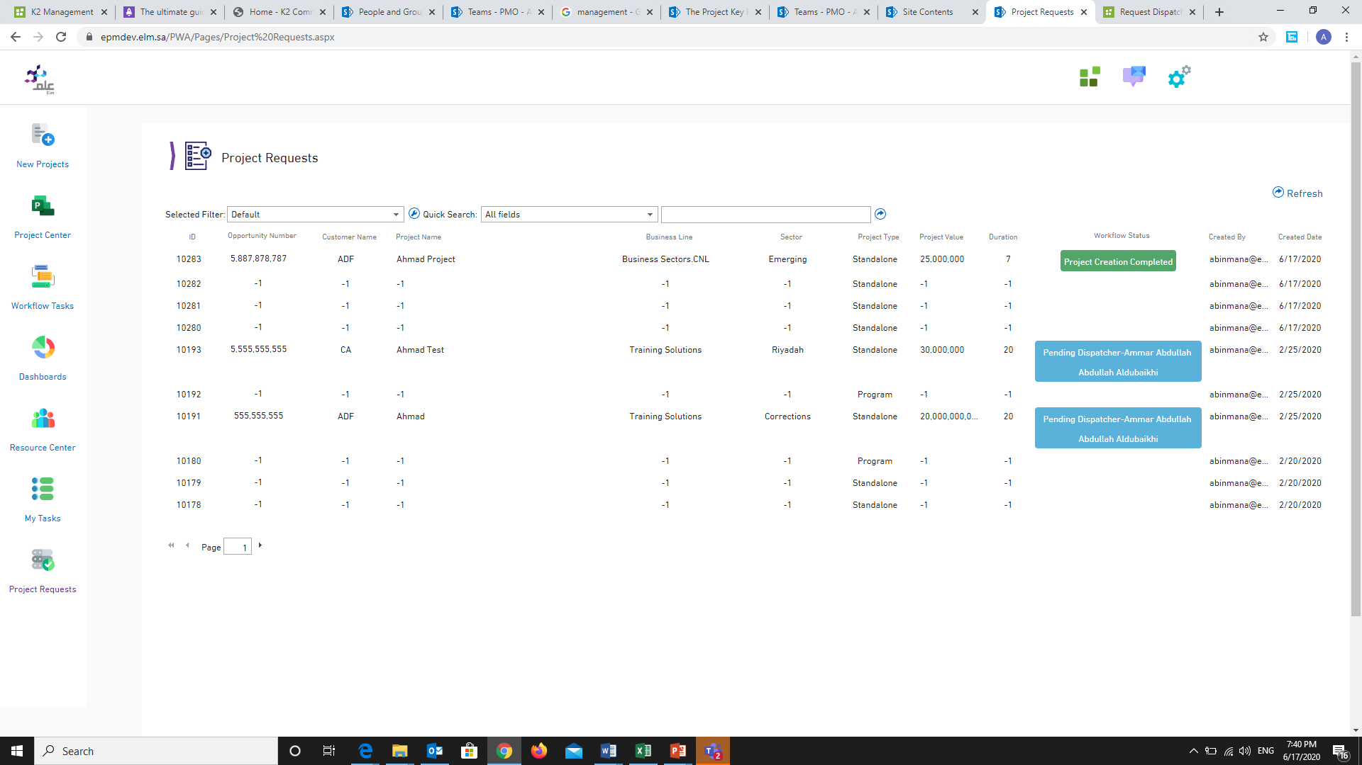
Here we can see the “project creation completed”

Slide 26
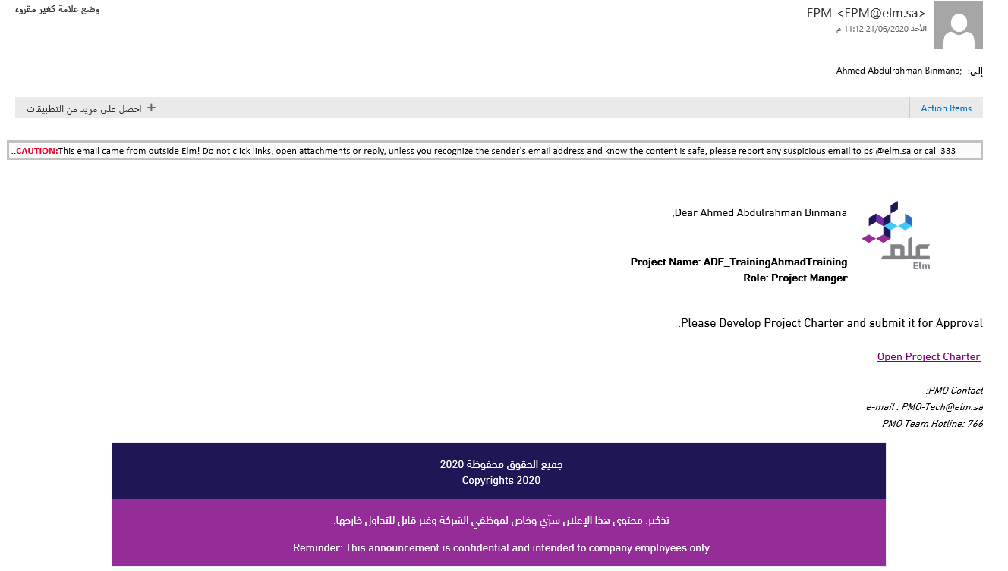
Then the project manager will receive
an email to Develop Project Charter
Click on the link to open project charter

Slide 27
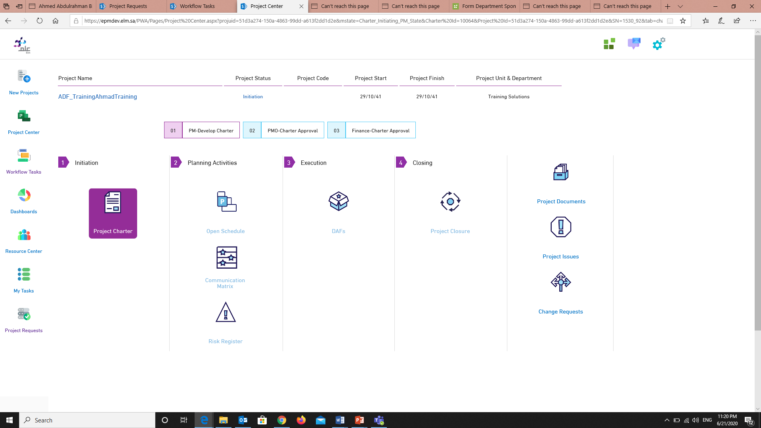
1
Project Documentation
You can upload any document
to your project from here
2
Project Issues
You can write all project
issue from here
Click on “Project Charter”
3
Change Requests
You can open any change to
your project from here
All these are not available until you finished project charter

Slide 28
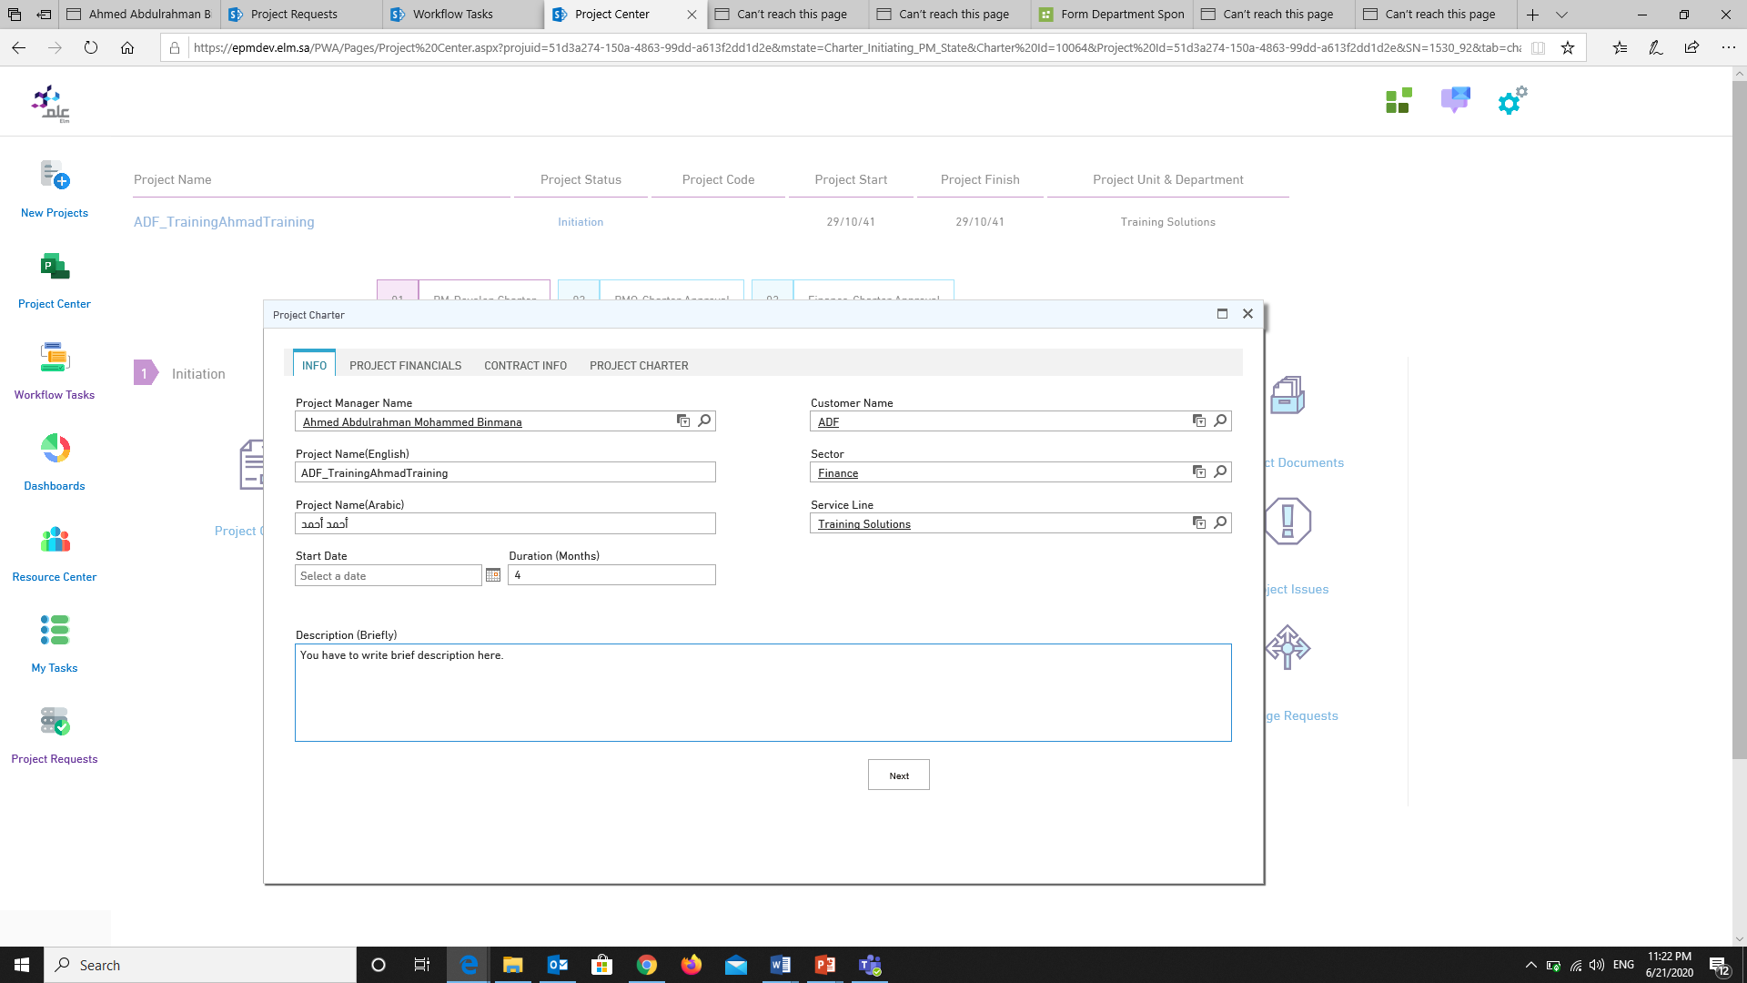

Slide 29
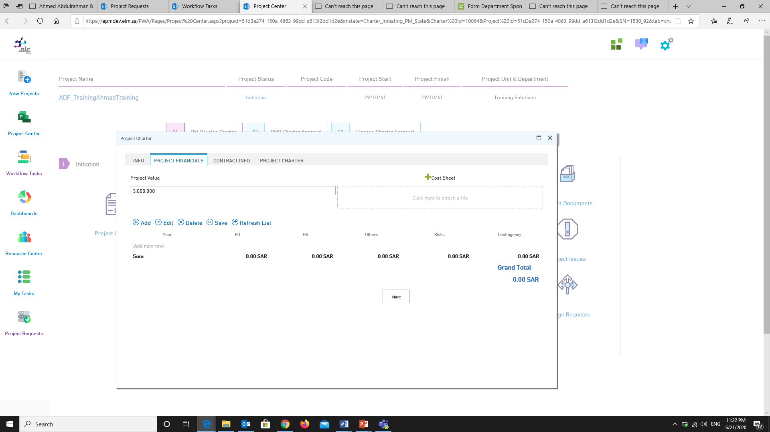

Slide 30
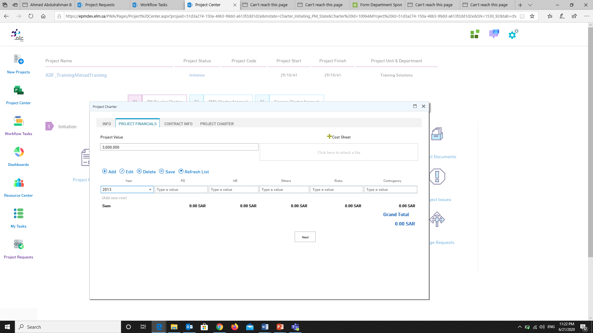
You have to fill each one of this list, if that required in your project.

Slide 31
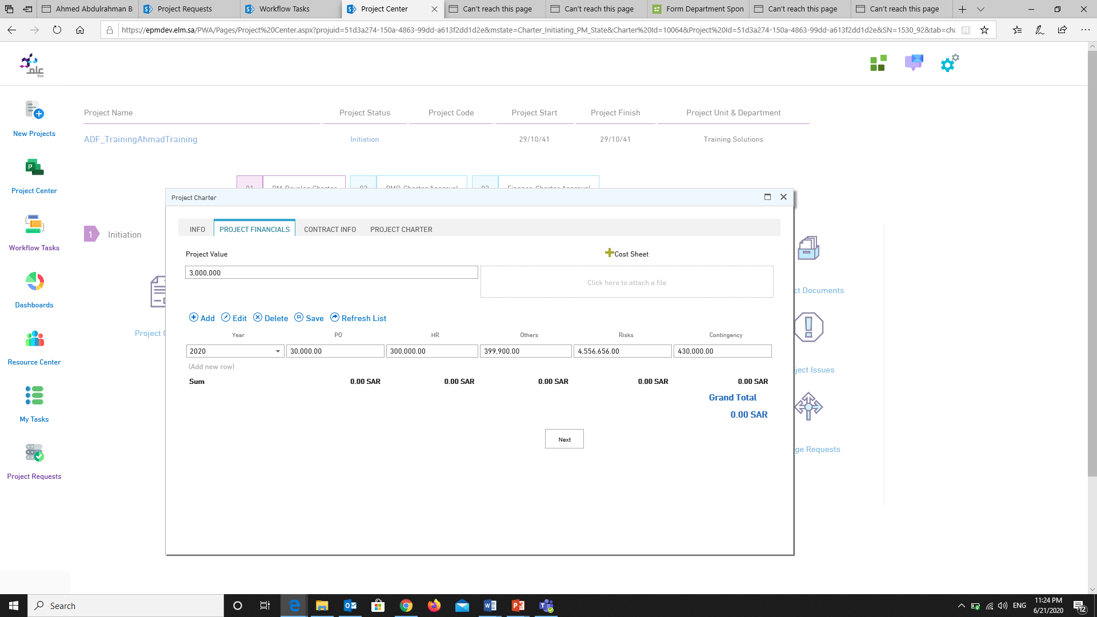

Slide 32
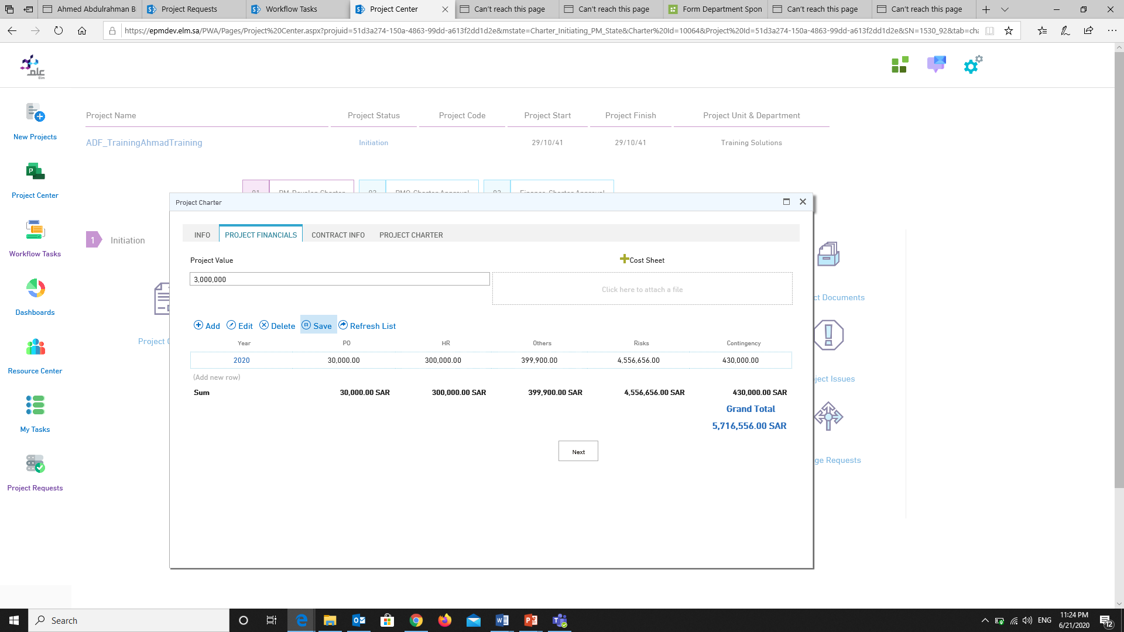
After you clicked on “Save” button, you will see the total here

Slide 33
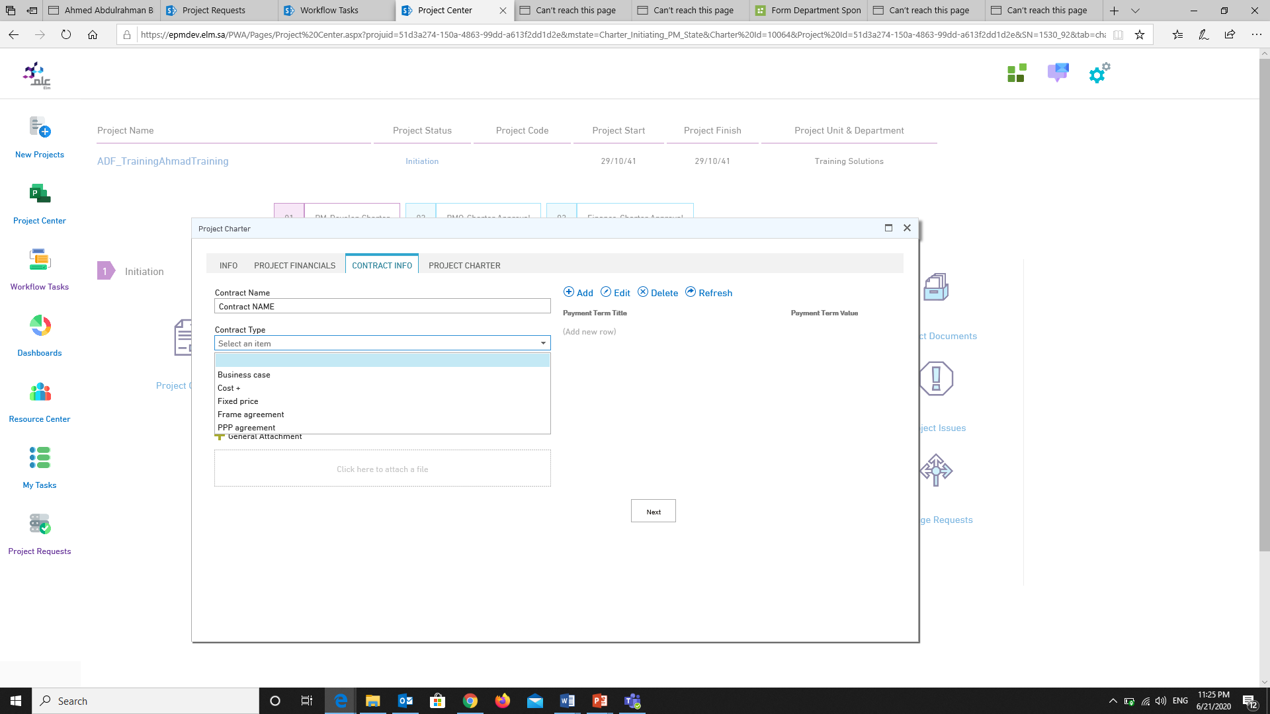
Here all “Contract Type”

Slide 34
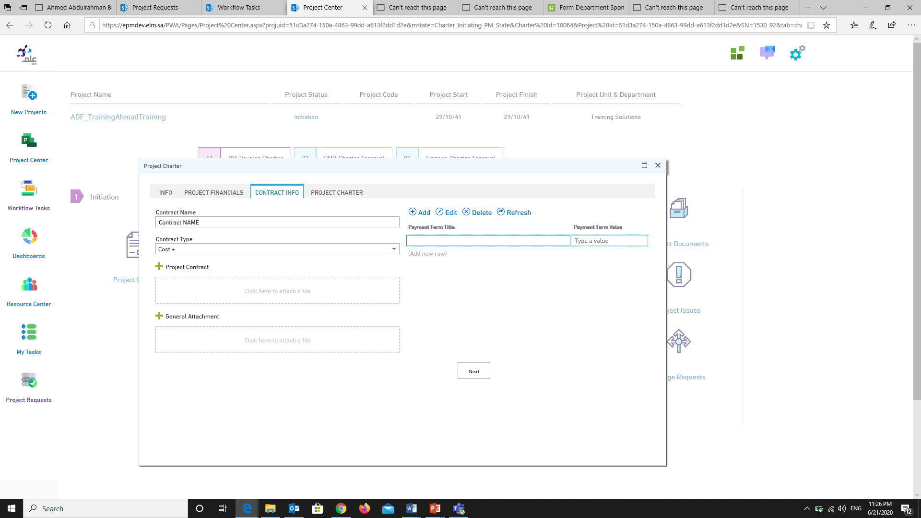
If you want to add “Payment Term”
just click on “Add”

Slide 35
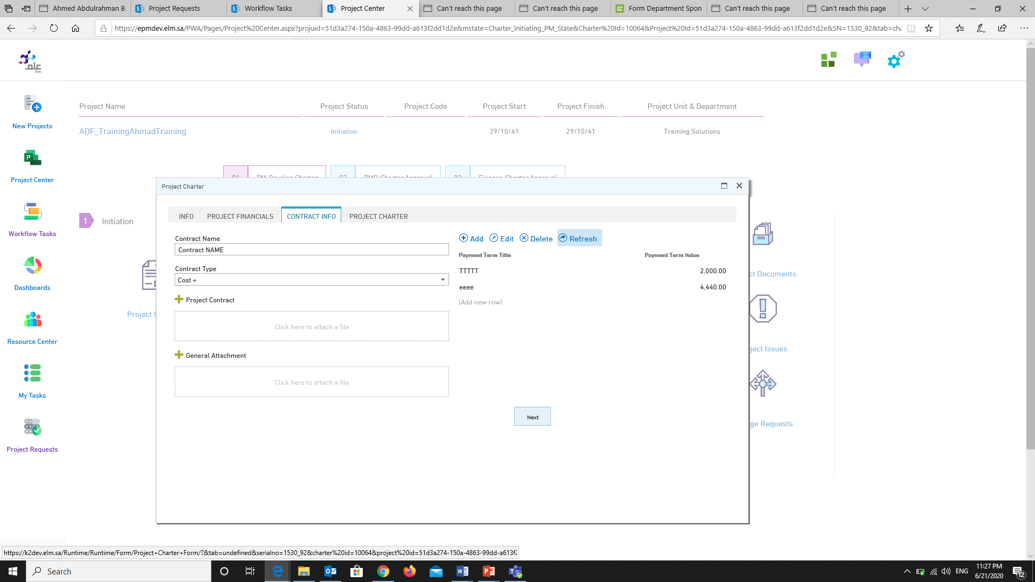
If you finished from “Contract Information” just click on “Next”

Slide 36
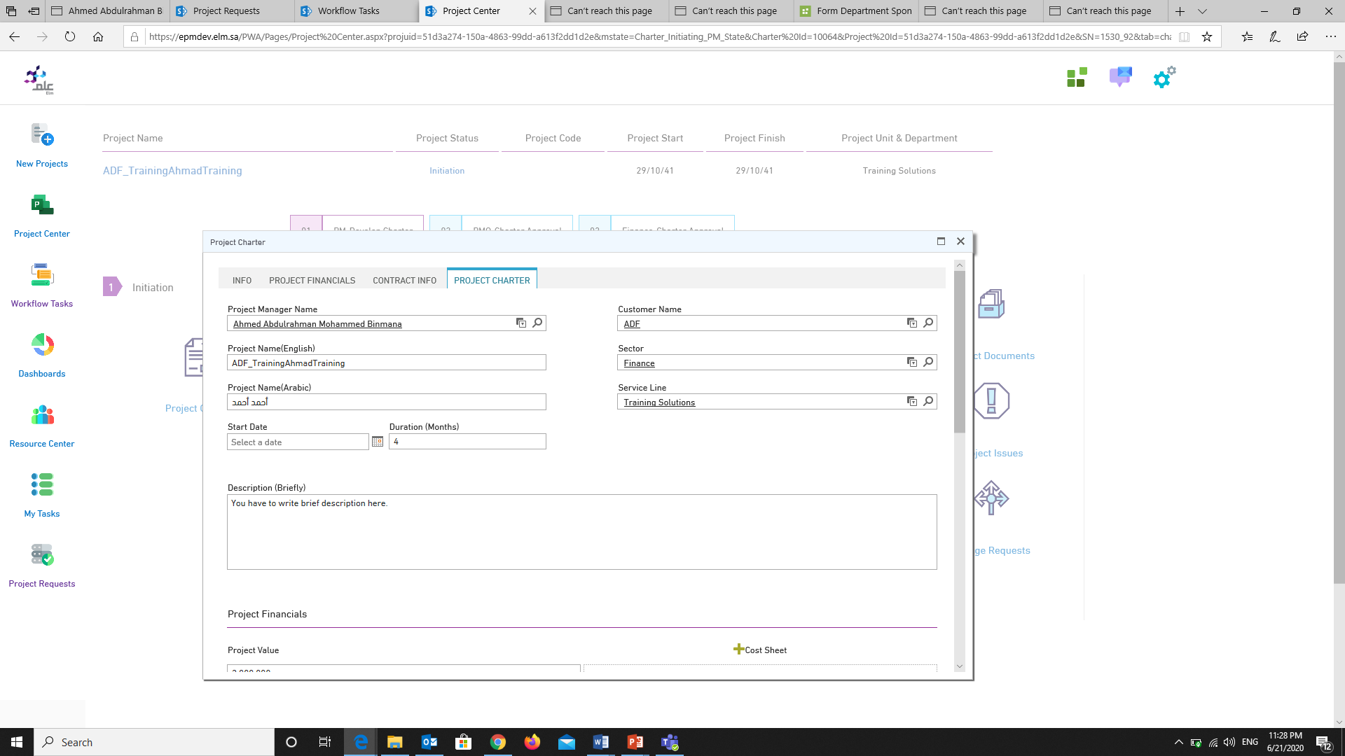

Slide 37
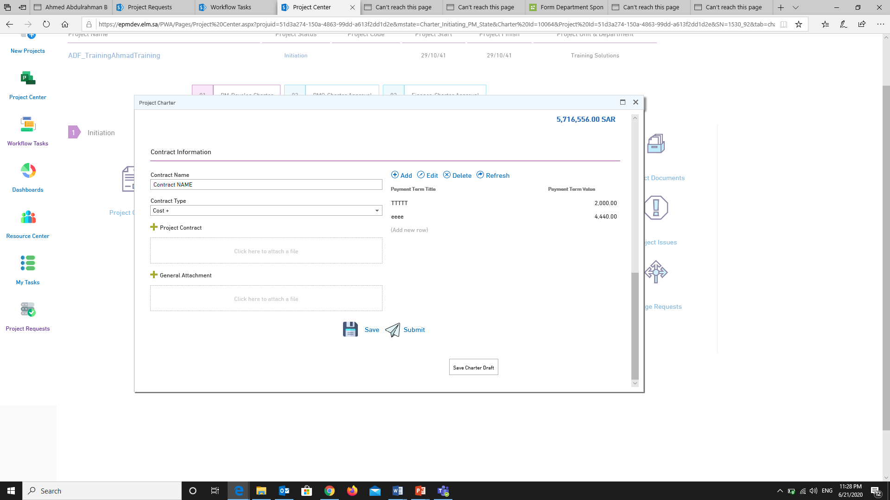
Here you have to options “Save” and “Submit”, if you are ready to submit the “Charter” juts click on “Submit” or click “Save” it as draft

Slide 38
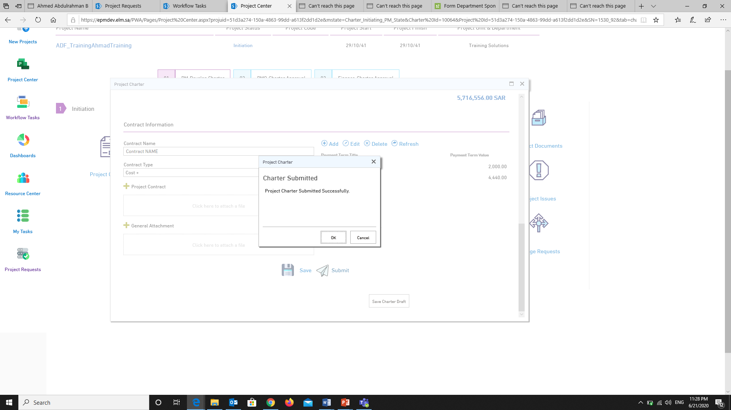

Slide 39
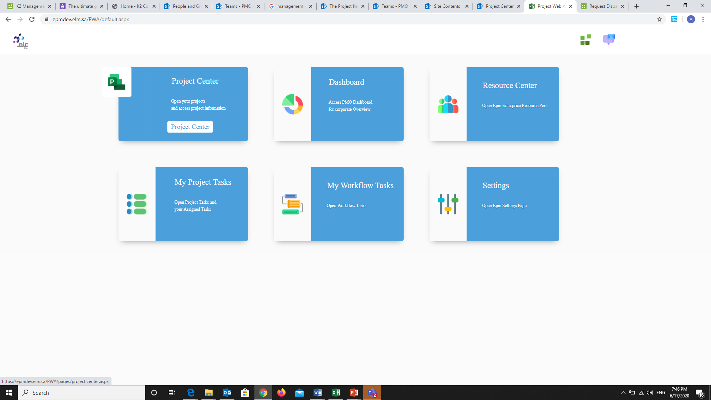
After the project completion, you can find your project in “Project Center”

Slide 40
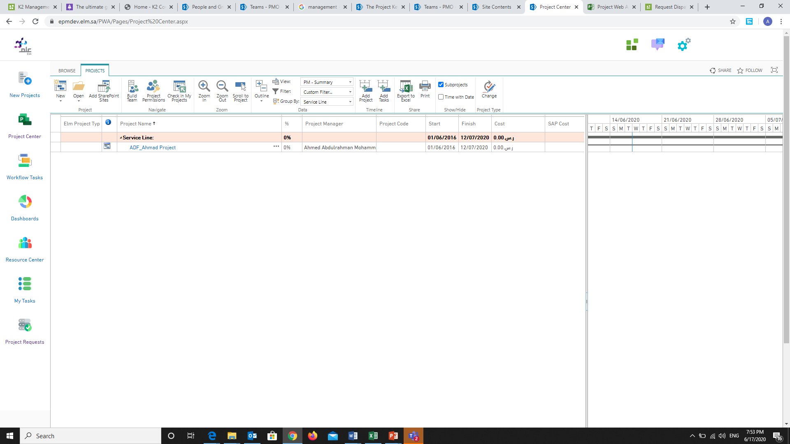
Here we can see that project we already created.

Slide 41
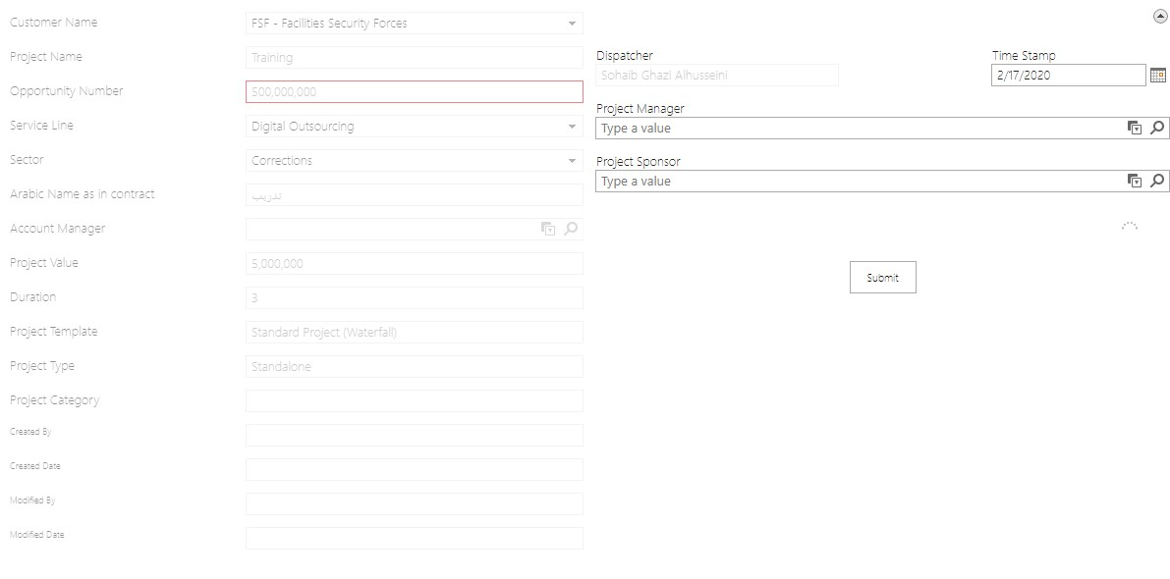
X

Slide 42
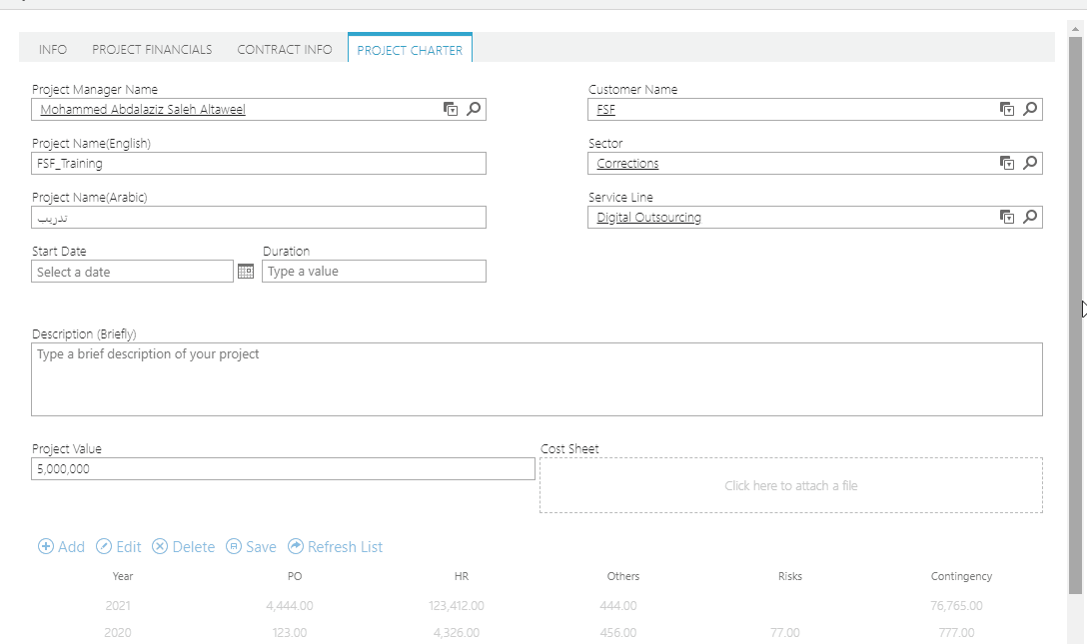
X

Slide 43
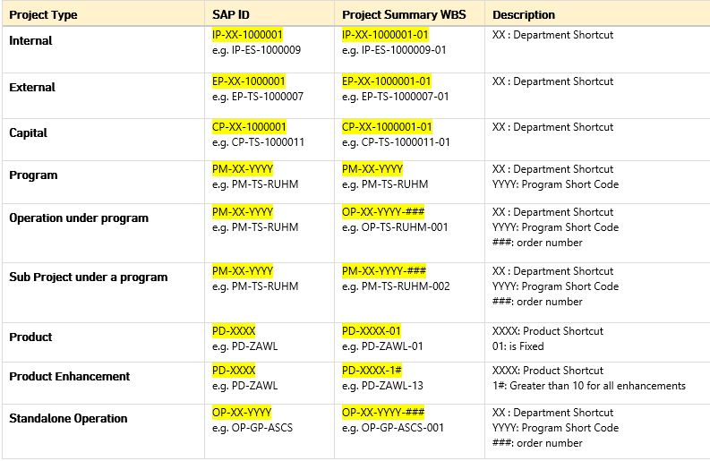
X

Slide 44

X

Slide 45

X

Slide 46

X

Slide 47
X

Slide 48
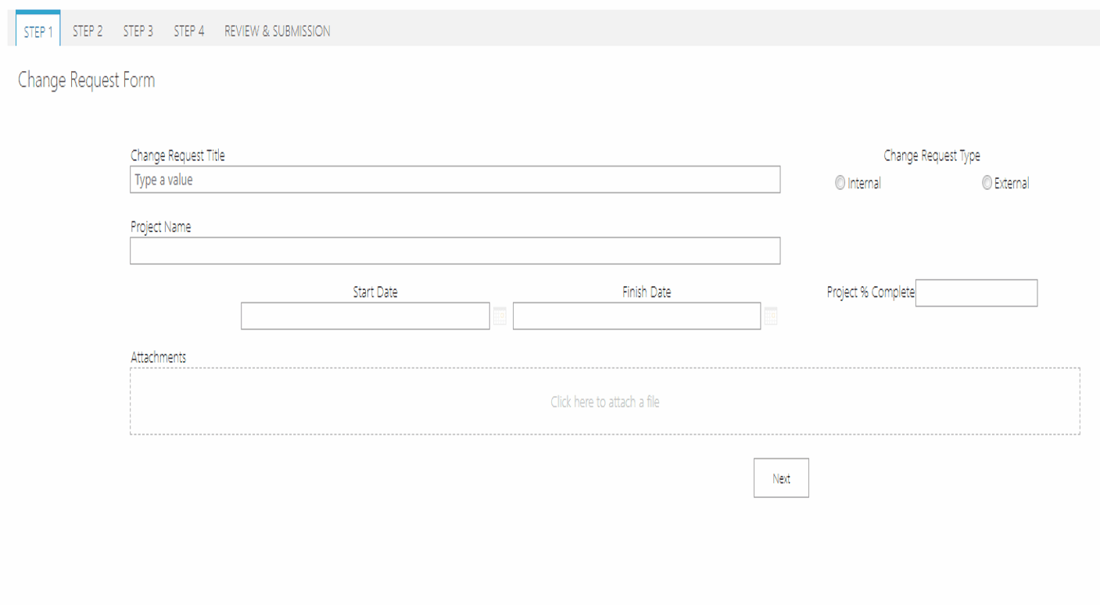
X

Slide 49
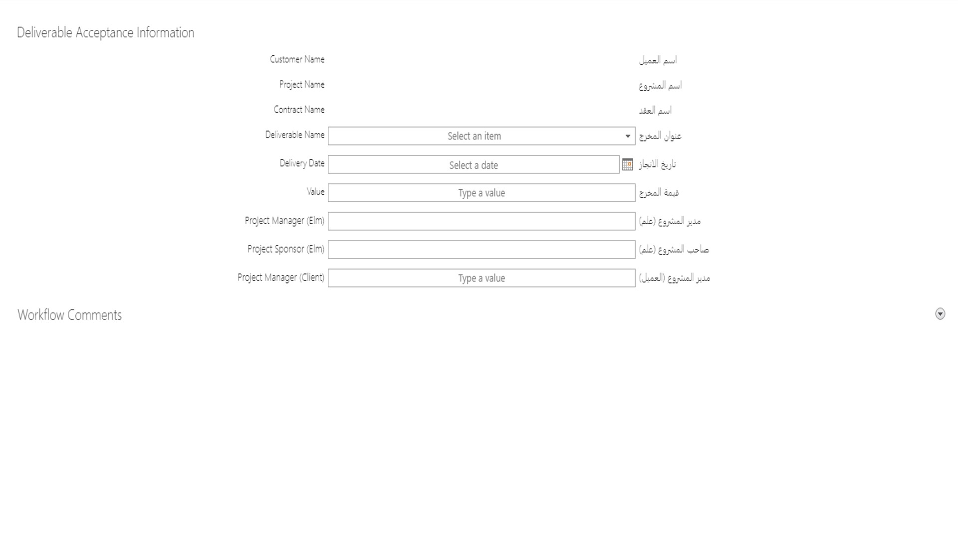
X

Slide 50
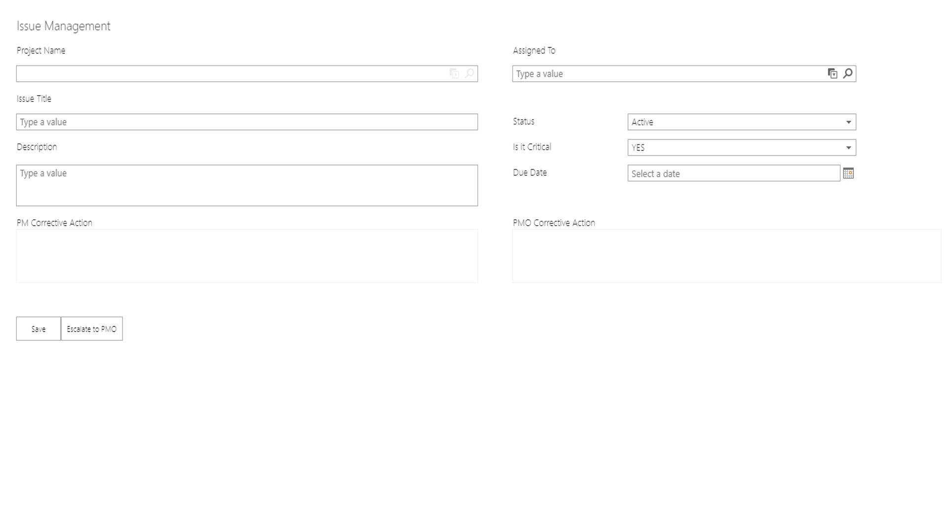
X

Slide 51
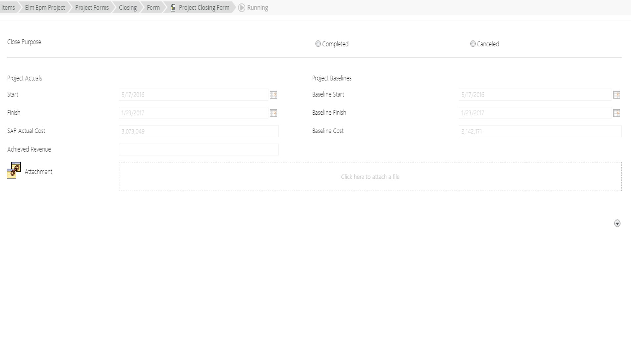
X

Slide 52
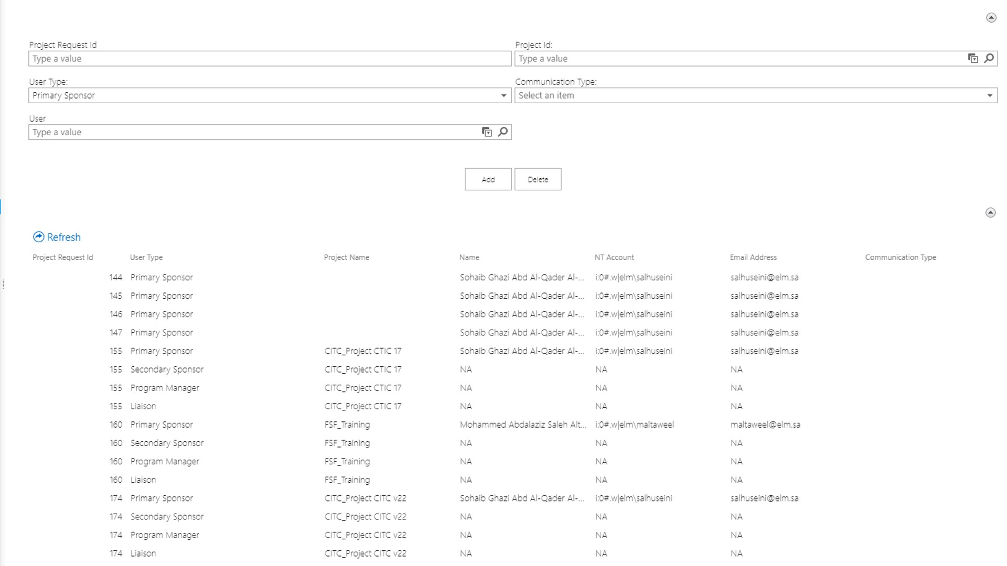
X

Slide 53

Thank You!
© Elm 2020

